Slide 1
Experimental Requirements (2025)
Wang Shuyi

Slide 2
Points to Note
Online + Offline Experimental Format
Key Dates
Attendance Policy

Slide 3
Online and offline experimental formats

Slide 4
Development systems vary
Comprehensive practical training
No single solution
Operating environments vary
Therefore divided into two parts
Two in-person sessions for convenient communication and Q&A
2 online sessions, facilitating group discussions and identifying suitable task execution environments

Slide 5
Avoid mutual interference

Slide 6


Slide 7
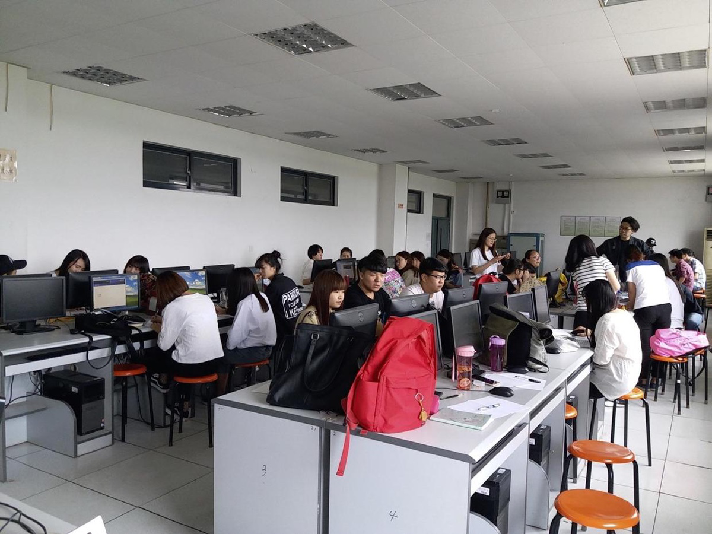

Slide 8
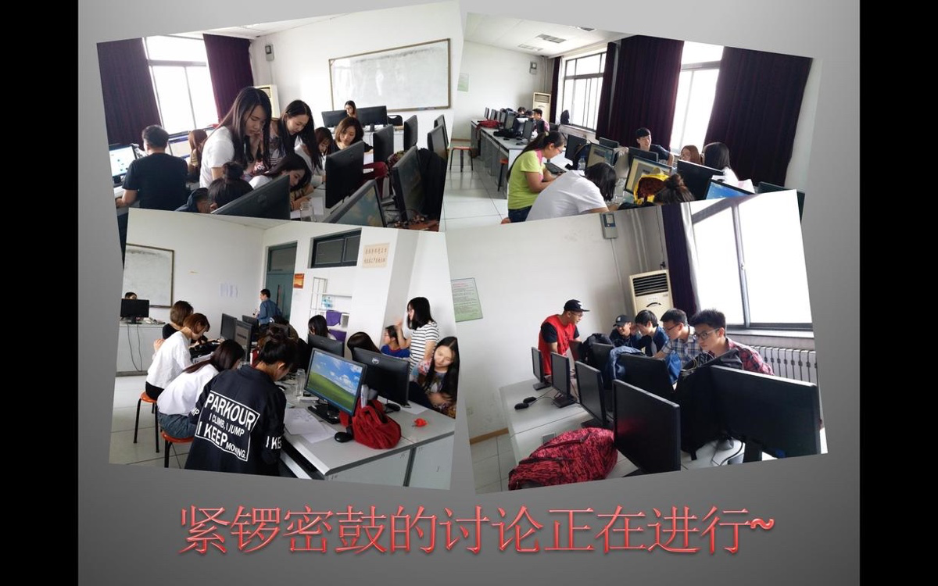

Slide 9
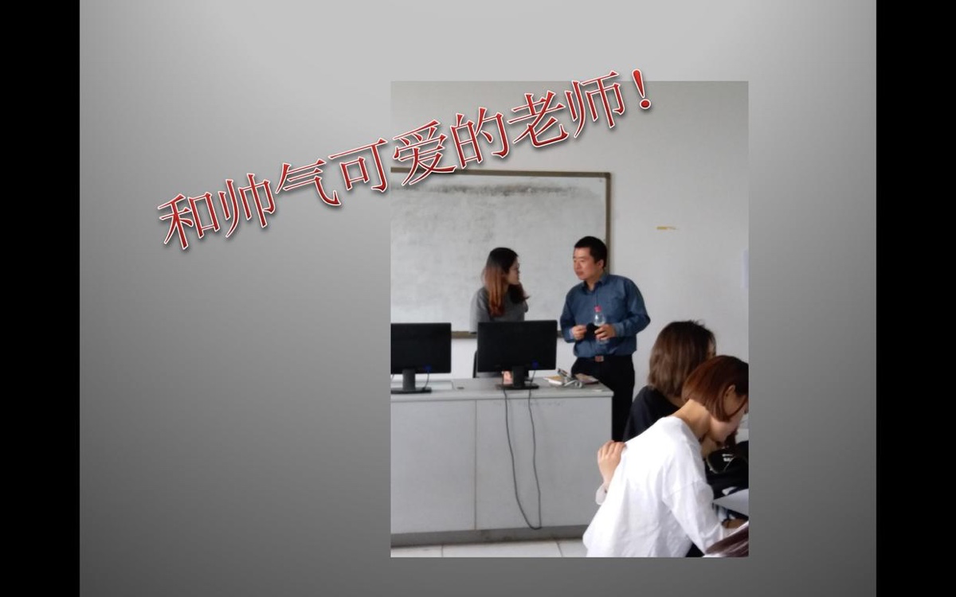

Slide 10
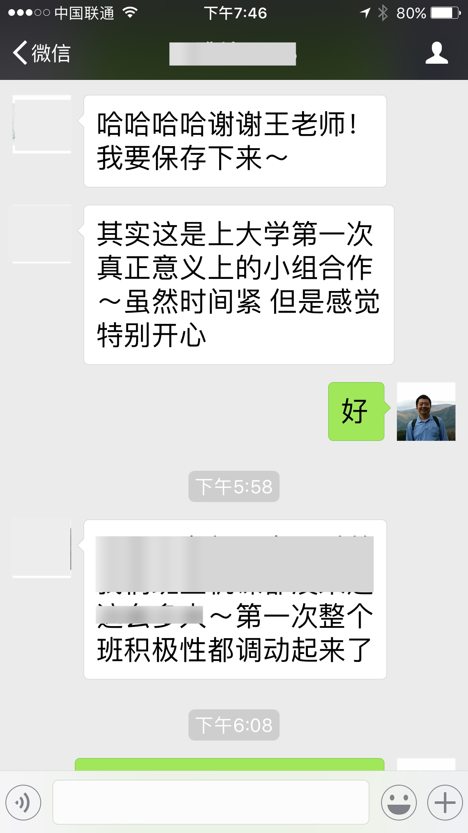

Slide 11


Slide 12
Assessment Method
Teaching Assistant Assessment
Peer Assessment
Presentation Defence

Slide 13
Teaching Assistant Assessment
Participation in Experiments (30%)
Completion Score (40%)
Peer assessment score (10%)

Slide 14
Interactive assessment
Must be taken seriously
Affects the group's overall score
Does not affect the scores of the evaluated group

Slide 15
Reason
Recognising Differences in Evaluation Criteria
Avoiding the bias of singular subjective evaluation

Slide 16
Presentation Defence
Outstanding Performance Selection (Maximum of 3 groups)
Spot Checks (Maximum of 3 Individuals)

Slide 17
Presentation Requirements
No slides permitted
Maximum use of whiteboard + handwritten notes

Slide 18
Application for Excellence
Voluntary Application for Participation
Teaching assistants will select up to three groups
Each group's current computer-based assessment score +10%

Slide 19
Award Selection
1-minute explanation of strengths
Demonstrate depth of thought and design

Slide 20
Outstanding Student Selection Results
For groups that pass, the remaining 20% of the computer-based assessment marks will be topped up to the full amount.
The final mark for the entire group will be increased by 3 points.

Slide 21
Random selection
Teaching assistants selected at random (excluding members already recommended for group selection)
The combined total of spot checks and excellence recommendations shall not exceed four
1-minute explanation of your contributions
Demonstrate critical thinking
Propose reasonable modifications to the experimental procedure based on changes in external technical conditions (optional)

Slide 22
Please note
Based on the results of the spot checks
The entire group's computer-based test scores fluctuated this time.

Slide 23
Examination and Spot Checks
To be implemented during the next computer-based session

Slide 24
Key dates
It is imperative to note
Timely completion is paramount
Missing deadlines will result in deductions based on the circumstances
Review the specific requirements for Feishu documents

Slide 25
The group leader is responsible for
During online computer sessions, the team shall endeavour to gather in person
Assign tasks to each member
Safety must be prioritised
e.g. Refrain from posing by the lake

Slide 26
Please note
Regarding the deletion/withdrawal of information and materials within the group
Relevant timestamps and original content serve as evidence for assessment
Arbitrary deletion or withdrawal may affect the assessment.

Slide 27
Emphasise
The use of artificial intelligence assistance is permitted
Cheating is not permitted

Slide 28
Question and Answer Session

